Slide 1

Data analysis in marketing context
Data analyst
Wageeh hella

Slide 2
The Business Problem
Anjum Hotel has been running various marketing campaigns to increase room bookings and enhance brand visibility. Despite investing significantly in these campaigns, the hotel management is unsure which channels yield the highest return on investment (ROI) and which campaign strategies are most effective. They want to optimize their marketing spend and maximize bookings and revenue.

Slide 3
Objective:
To analyze the effectiveness of different marketing campaigns and channels, determine which ones drive the most bookings and revenue, and provide data-driven recommendations to optimize future marketing efforts.

Slide 4
Study of hotel marketing report
1. Which company had the highest revenues and lowest spending?
2. Which channel got the most booking, clicks and impressions?
3. Which category provides the most revenue?
4. Which company provided the lowest revenue and highest spending?
5. What was the period during which revenues were high?
6. What is the best marketing channel?

Slide 5
1. Which company had the highest revenues and lowest spending?
the highest company return on investment (ROI) is company 29 which As it is for every expenditure $1 offers a return of $14 Through the social media channel

Slide 6
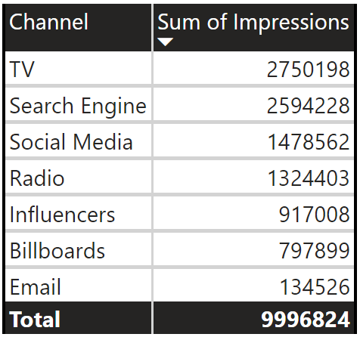
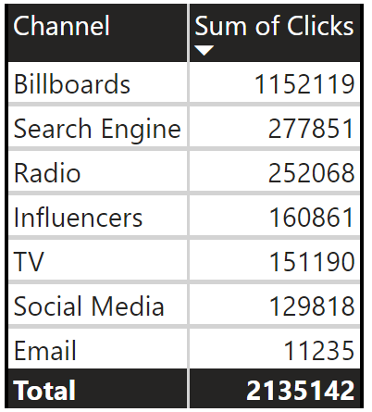
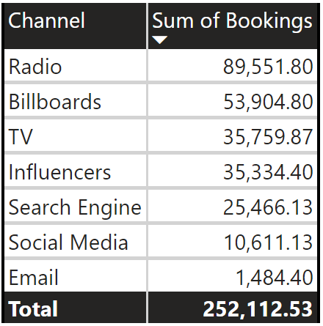
2. Which channel got the most views, clicks and impressions?

Slide 7
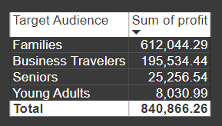
3. Which category provides the most revenue?

Slide 8
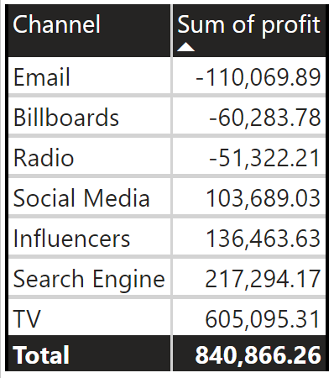
4. Which company provided the lowest revenue and highest spending?

Slide 9
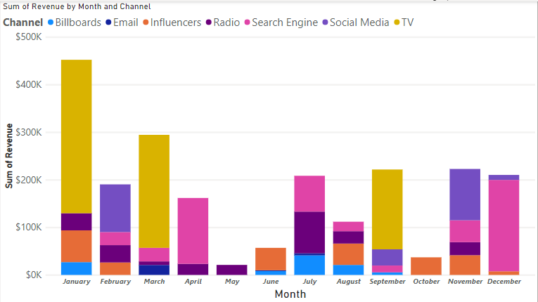
5. What was the period during which revenues were high?

Slide 10
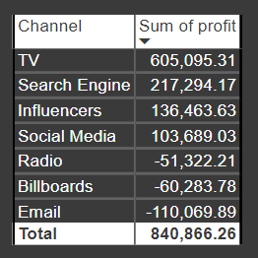
6. What is the best marketing channel?
TV
Is the best channel

Slide 11
Recommendation
Invest on Marketing for TV channel As it’s the highest revenue channel
Create special offers and packages for family Because it is the category that provides the most revenue
Reduce marketing via radio or email or billboard because they offer less return on expenditure
Invest on Marketing for social media channel special company 29 which As it is for every expenditure $1 offers a return of $14
Increase marketing on January for more revenue

Slide 12
Thank you!!

